Slide 1
EVOLUTIONARY COMPUTATION IN CONTINUOUS OPTIMIZATION AND MACHINE LEARNING
Status and planning seminar

Slide 2
Introduction
Optimization & Evolutionary Computation

Slide 3
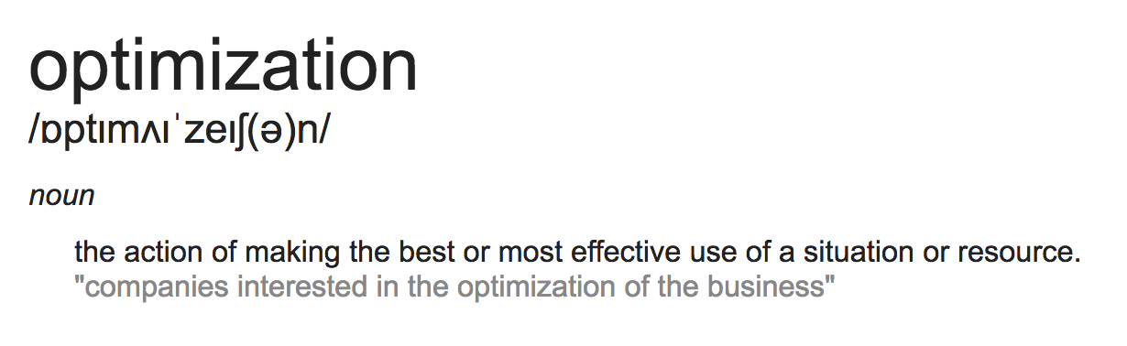
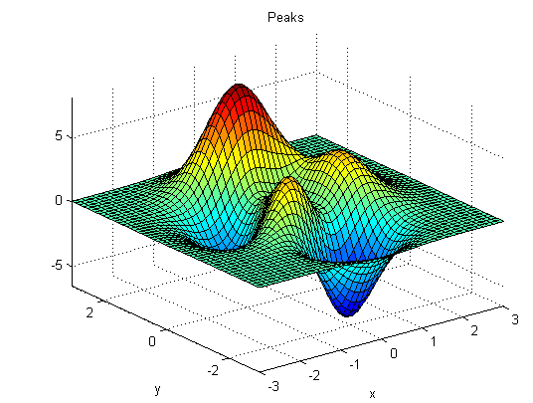
Optimization

Slide 4
Evolutionary Computation
Evolutionary computation focuses on problem solving algorithms which draw inspiration from natural processes.
The basic rationale of the field is to adapt the mathematical models of biological Darwinian evolution to optimization problems.
The usefulness of this can be illustrated by imagining that an organism acts as an “input” to the “model” of it’s natural environment and produces an “output” in the form of offspring. Through multiple iterations biological evolution culls the population of organisms, only keeping the fit specimen, to produce organisms which become continuously better adapted to their environments.

Slide 5
Thesis Purpose
Explore the performance and usefulness of three emerging evolutionary algorithms:
Differential evolution
Particle swarm optimization
Estimation of distribution algorithms.
Test them on benchmarks
Mathematical function optimization
Machine learning tasks
Develop a new or modified algorithm which improves upon the aforementioned ones in some aspect

Slide 6
Background
Evolutionary Algorithms & Machine Learning

Slide 7
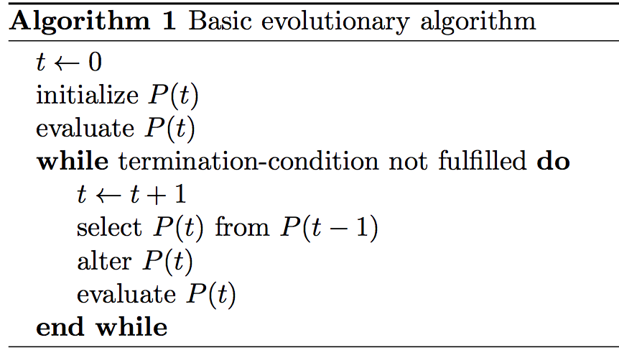
Evolutionary Algorithms
Works on the concept of populations
A population is a set of individuals
Individuals contain a vector of parameters

Slide 8
Evolutionary Algorithms: Concepts 1
Representation
Binary
Integer
Floating point
Tree
Evaluation function
Population
Steady state
Generational
Parent selection
Fitness proportional
Ranking
Tournament

Slide 9
Evolutionary Algorithms: Concepts 2
Variation
Mutation
Recombination
Survivor selection
Initialization
Termination condition

Slide 10
Traditional Evolutionary Algorithms
Genetic Algorithms
Evolution Strategy
Evolutionary Programming
Genetic Programming

Slide 11
Emerging Evolutionary Algorithms
Differential Evolution
Particle Swarm Optimization
Estimation of Distribution Algorithm

Slide 12
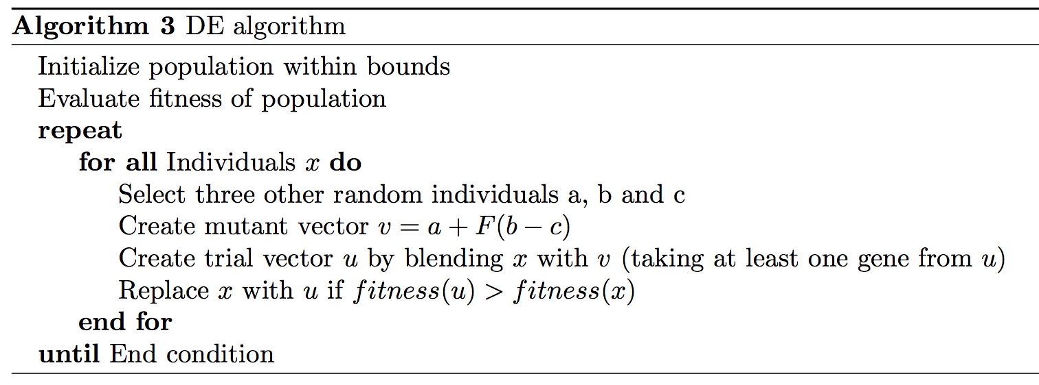
Differential Evolution
Individuals are mutated using the differences between individual vectors
New individuals replace old individuals only if they perform better

Slide 13
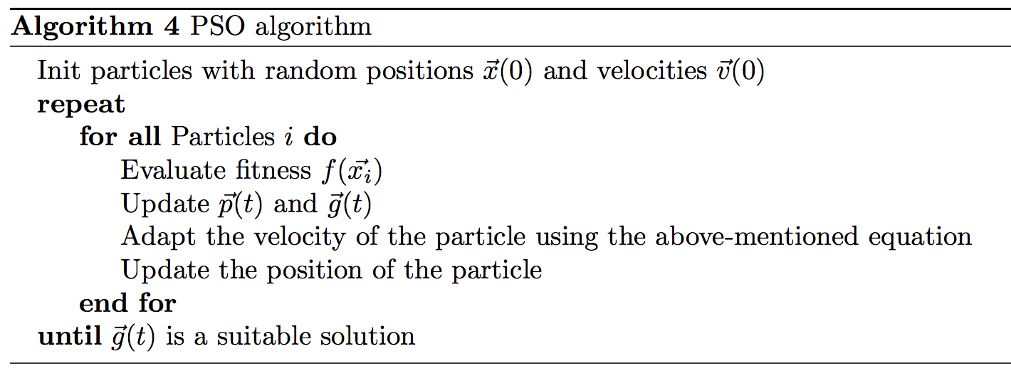
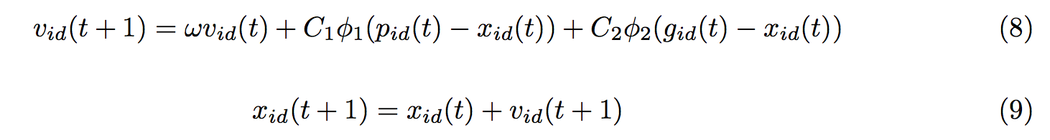
Particle Swarm Optimization
Works with swarms of individuals which follow both their own “intuition” and the swarm as a whole
Uses an update formula to accomplish variation:

Slide 14
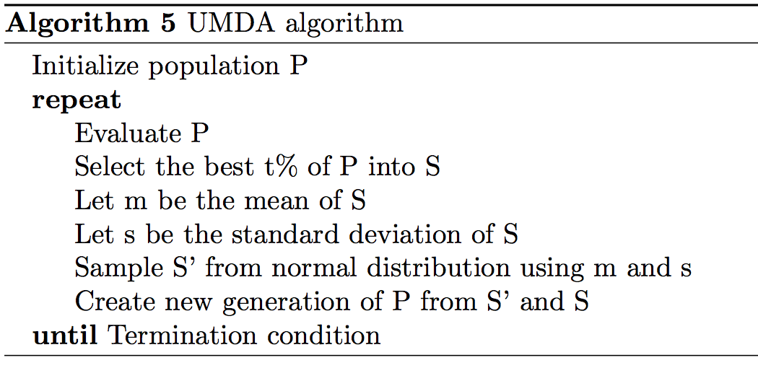
Estimation of Distribution Algorithm
Uses probability distributions to record and sample good solutions
Different types of distributions provide different results
The choice of distribution depends on the complexity of the problem

Slide 15
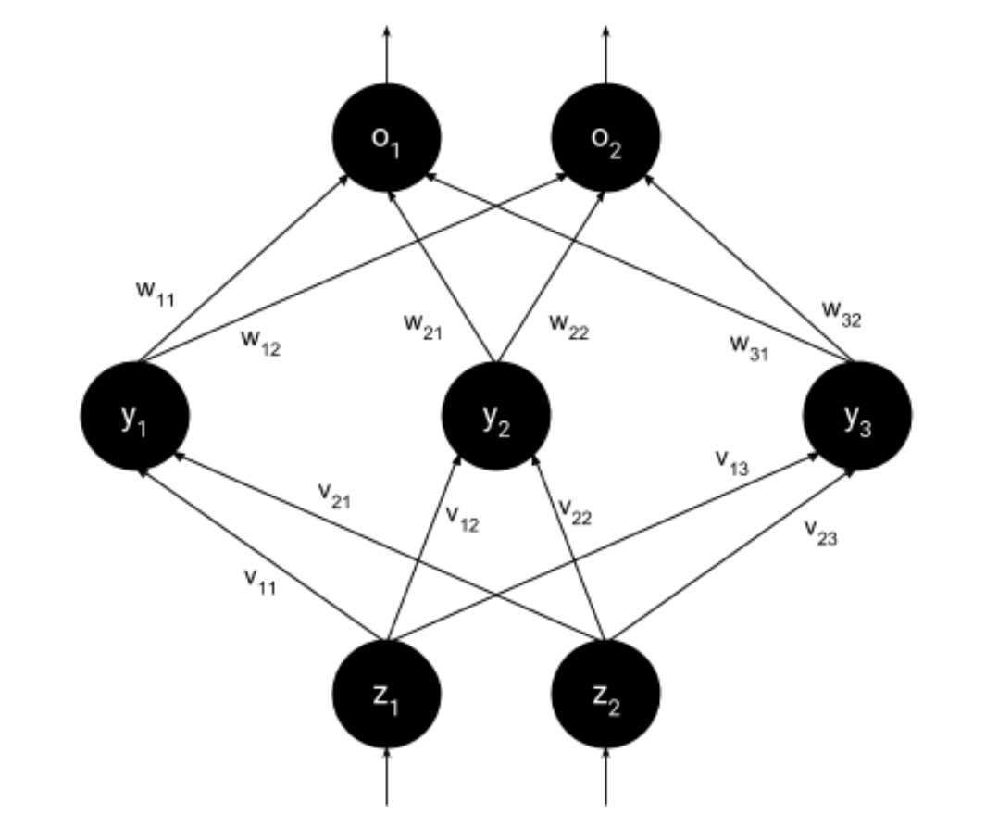
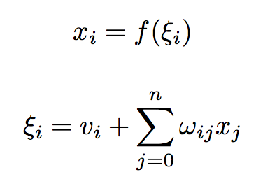
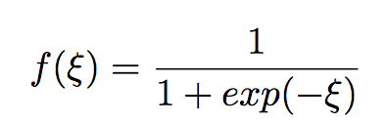
Machine Learning Concepts
Artificial Neural Networks
Feed-Forward Neural Networks
Back-propagation

Slide 16
Related Work
Recent Research, Emerging Evolutionary Algorithms and Contributions

Slide 17
Roots
Ideas around evolutionary computation began emerging in 1950s
Several researchers, independently from each-other, created algorithms which were inspired by natural Darwinian principles, these include Holland’s Genetic Algorithms, Schwefel’s and Rechenberg’s Evolution Strategies and Fogel’s Evolutionary Programming.
Research has shown that no single algorithm can perform better than all other algorithms on average. This has been referred to as the ‘no-free-lunch’ and current solutions instead aim at finding better solutions to specific problems by exploiting inherent biases in the problem.

Slide 18
Recent Research
Parallelism
Multi-population models
Multi-objective optimization
Dynamic environments
Evolving executable code

Slide 19
Research: Differential Evolution
Conceived in 1995 by Storn and Price
One of the best algorithms in continuous optimization
Hybrids of the algorithm
self-adaptive DE
opposition-based DE
DE with global and local neighborhoods
DE uses very few parameters and the effects of altering these parameters have been well studied
DE comes in a total of 10 different varieties
DE/best/1/bin generally yields the best results

Slide 20
Research: Particle Swarm Optimization
Most widely used swarm intelligence algorithm to date
Modified versions
quantum-behaved PSO
bare-bones PSO
chaotic PSO
fuzzy PSO
PSOT-VAC
opposition-based PSO
Hybridized with other evolutionary algorithms

Slide 21
Research: Estimation of Distribution Algorithms
Use probabilistic models to solve complex optimization problems
Successful at many engineering problems which at which other algorithms have failed
military antenna design, protein structure prediction, clustering of genes, chemotherapy optimization, portfolio management
Improvements
Parallelization of fitness evaluation and model building
Local optimization techniques (deterministic hill climbing)

Slide 22
Research: Machine Learning and Evolutionary Computation
Many attempts have therefore been made to combine the two
ML has been used to improve EC optimization algorithms
EC has been used to improve ML techniques
Using DE to optimize feed-forward neural networks
Using PSO to initialize weights and biases in a neural network before training

Slide 23
Contributions
EC is a an interesting alternative to traditional approaches in machine learning and continuous optimization and while algorithms such as DE, PSO, etc. have been compared on mathematical benchmarks before, the application of EC to machine learning has not been studied with as much detail.
My primary contribution to the field will be to find what algorithms work best for different ML problems and based on this propose ML-specific improvements.

Slide 24
Problem formulation
Benchmarks, Measurements and New Algorithms

Slide 25
Research Questions
How do DE, PSO and EDA perform comparatively when applied to mathematical optimization problems?
How do DE, PSO and EDA perform comparatively when applied to machine learning problems such as neural network optimization and artificial intelligence in games
How are DE, PSO and EDA suited to these different problems?
Can an improved algorithm which draws inspiration from the design of DE, PSO and/or EDA outperform any of them in some/all of the aforementioned benchmarks and problem sets?

Slide 26
Outcomes
Benchmark DE, PSO, EDA on mathematical optimization problems
Benchmark DE, PSO, EDA on machine learning problems
Develop a new algorithm inspired by DE, PSO and/or EDA
Benchmark the new algorithm
Compare the new algorithm with DE, PSO and EDA and draw conclusions from the results

Slide 27
Time plan

Slide 28
Time Plan
The first two weeks will serve as an introduction to the topic and the introduction and background section of the report will be completed during this period. This will guarantee that they will be available in time for the status and planning seminary.
After this, deeper inquiry into the main algorithms of the thesis will be conducted and the first implementation prototypes will be constructed. During this time a benchmark methodology will also be decided. This phase might occupy 1 - 3 weeks.
It will be followed by a benchmark and an investigation of how to apply the algorithms to machine learning problems. This will probably occupy one week.
It will be followed by the development of an improved algorithm and the implementation of the machine learning benchmarks.
After this a complete benchmark of all four algorithms on both standard functions and machine learning problems will be conducted.his should leave enough time over to fine tune the new algorithm and finalize the report before the end of the course/project period.

